Slide 1


A Manifesto for Future Generation Cloud Computing: Research Directions for the Next Decade
Cloud Computing - LTAT.06.008 – Lecture 14
Satish Srirama
satish.srirama@ut.ee
Notes:
Ome Srirama Jai Vinayaka
Ome Srirama Jai Vinayaka
Ome Srirama Jai Vinayaka

Slide 3
Cloud Computing
Cloud computing paradigm has revolutionized the computer science horizon
Enabled the emergence of computing as the fifth utility
Emerged as the backbone of modern economy
  Offered subscription-based services anytime, anywhere following a pay-as-you-go model
Instigated
  Shorter establishment times for start-ups
  Creation of scalable global enterprise applications
  Better cost-to-value associativity for scientific and high-performance computing applications
  Different invocation/execution models for pervasive and ubiquitous applications
Notes:
5th utility (after water, electricity, gas, and telephony)

Slide 4
Motivation and Goals of Cloud Manifesto
Basic service models
  IaaS, PaaS, SaaS
These models advanced and new ones emerged
Cloud technologies also advanced
  E.g. virtualization
Emerging application domains posed new challenges
  E.g. scale in IoT
Need to re-evaluate the models and research strategies
Future generation cloud computing

Slide 5
Structure of the Manifesto
Discusses major challenges in cloud computing
  Investigates their state-of-the-art solutions
  Investigates their limitations
Emerging trends and impact areas, that further drive these challenges
Offers comprehensive future research directions

Slide 6
Major Challenges in Cloud Computing

Slide 7
Scalability and Elasticity
Cloud computing promises virtually unlimited computational resources on demand
Benefits:
  Scalability: Unexpected peaks in computational demand do not break service level agreements (SLAs)
  Elasticity: Users do not need to make significant up-front investments in infrastructure
    Rather grow/shrink as their computing needs increase/decrease
State-of-the-art:
  Models for Auto-scaling, scaling policies, resource provisioning policies

Slide 8
Scalability and Elasticity – challenges, and open issues
Research challenges associated with scalable services
  Cloud providers must embrace parallel computing hardware
    Multi-core, clusters, accelerators (GPUs), non-traditional (e.g., neuromorphic and future quantum) architectures
    Provide heterogeneous hardware to users in abstractions (e.g. VMs, containers)
  Middleware level: Programming models and abstractions are necessary
  Application level: New scalability algorithms and models
Scalability of the Cloud is limited by the extent to which individual components, namely compute, storage and interconnects scale
  End of scaling of Moore’s law (Doubling the number of transistors every 1.5 year)
  Research in new technologies (e.g. beyond Metal-Oxide-Semiconductor)
  For memory, new non-volatile technologies are being explored
Research challenges associated with elastic services
  Ability to accurately predict computational demand
  Dynamic creation, mobility, and garbage collection of VMs and containers
  Programming models that enable dynamic reconfiguration of applications
Notes:
Neuromorphic engineering, also known as neuromorphic computing, is a concept developed by Carver Mead, in the late 1980s, describing the use of very-large-scale integration (VLSI) systems containing electronic analog circuits to mimic neuro-biological architectures present in the nervous system.

Slide 9
Emerging trends and impact areas for cloud
Containers
  New type of virtualization technology with tiny memory footprint, lesser re-source requirement and faster startup
Fog Computing
  Computing at the edge of the network
Big Data
  Rapid escalation in the generation of streaming data from IoT and social networking applications
Serverless Computing
  Architectural pattern where the server is abstracted away and the resources are automatically managed for the user
Software-defined Cloud Computing
  Optimizing and automating the Cloud configuration and adaptation by extending the virtualization to compute, storage, and networks
Blockchain
  Distributed immutable ledger deployed in a decentralised network that relies on cryptography to meet security constraints
Machine and Deep Learning
  Algorithms and models for optimized resource management and ML services offered from Clouds

Slide 10
Scalability and Elasticity – Future Research Directions
Special-purpose clouds for specific functions
  Deep learning e.g., Convolutional Neural Networks, Multi-Layer Perceptrons, and Long Short-Term Memory
  Cloud providers are already offering accelerator and special-purpose hardware e.g. Amazon GPUs, Google TPUs
Need to develop appropriate virtualization and programming abstractions
  Enabling just-in-time compilation and optimization for special-purpose hardware
Appropriate economic models
  e.g., Offering image and video processing as composable micro-services
To address large-scale communication-intensive applications, further Cloud provider investments are required
  to support high-throughput and low-latency networks
Decentralized scalable distributed algorithms for edge, hybrid and inter-clouds

Slide 11
Resource Management and Scheduling
Modern CDCs contain tens to hundreds of thousands computing and storage devices
  Host complex applications and relevant data
Effective resource management and scheduling policies are important to achieve high scalability and operational efficiency
IaaS providers mostly rely on
  Static VM provisioning policies
    Allocate a fixed set of physical resources to VMs using bin-packing algorithms
  Dynamic policies
    Handling load variations through live VM migrations and other load balancing techniques
Policies available at PaaS and SaaS level
  Auto-scaling techniques
  Resource throttling methods
    To handle workload bursts, trends, control usage of preemptible VMs
  Admission control methods
    To handle peak load and prioritize workloads of high-value customers
  Service orchestration and workflow schedulers
    To compose and orchestrate workloads (e.g., scientific data workflows)
Notes:
Resource throttling refers to the artificial cutting down or lowering of the amount of resources or returns in a system.

Slide 12
Resource Management and Scheduling - Challenges
Existing management policies tend to be intolerant to inaccurate estimates of resource requirements
  Need to study novel tradeoffs between policy optimality and its robustness to inaccurate workload information
Resource management policies tend to focus on optimizing specific metrics and resources
  Often lack a systematic approach to co-existence in the same environment of multiple control loops
Methods for hybrid Clouds and federated Clouds
Risks related to the interplay between security and resource management

Slide 13
Resource Management and Scheduling - Future Research Directions
Cooperative resource management between centralized CDCs and distributed Edge computing resources for real-time processing
Novel scheduling methods for the distributed and heterogeneous environments
Serverless computing offloads the computation far from the application core components
  Network latency can visibly affect function response time
  Novel resource management policies to decide when and to which extent to rely on FaaS
Providers and consumers, often have different goals and constraints
  Novel game-theoretic approaches and market-oriented models for resource allocation and regulation
AI driven management
By logically centralizing the network control plane, SDNs provide opportunities for more efficient management of resources
  SDN-driven orchestration and consolidation
  Efficient algorithms to exploit these features

Slide 14
Reliability
Cloud computing systems face a variety of reliability-related threats
  Hardware failures, resource missing failures, overflow failures, network failures, timeout failures, and flaws in software being triggered by environmental change
A cascade of failures may be triggered leading to large-scale service disruptions with far-reaching consequences
Reliability has a great impact on the QoS as well as on the long term reputation of the service providers
State-of-the art:
  Replication of data and computation (e.g. MapReduce)
  Erasure coding for data storage
Notes:
Erasure coding (EC) is a method of data protection in which data is broken into fragments, expanded and encoded with redundant data pieces and stored across a set of different locations or storage media.

Slide 15
Reliability - Challenges
Standard fault-tolerance and reliability approaches of traditional distributed systems cannot be directly applied in Cloud computing systems
  Cloud computing is typically more service oriented rather than resource oriented
Scale and expected reliability are hard to analyze due to the range of inter-related characteristics
  e.g., their massive-scale, service sharing models, wide-area network, and heterogeneous software/hardware components.
Independent failures have mostly been addressed separately; however, their interplay has been mostly ignored
Cloud environments lack thorough service reliability models, automatic reliability-aware service management mechanisms, and failure-aware provisioning policies

Slide 16
Reliability - Future Research Directions
How to deliver a competitive service that meets end users’ expectations for performance, reliability, and QoS in the face of various types of independent as well as temporal and spatial correlated failures?
Innovative Cloud services that provide reliability and resilience with assured service performance (Reliability as a Service)
Deep and machine learning for failure prediction
Failure aware resource provisioning policies
Beyond replication for new type of applications such as IoT applications
Employing both replications and erasure coding in cloud storage for Big Data applications
Reliability and energy efficiency correlation

Slide 17
Sustainability
CDC deployments until recently have mainly focused on high performance and have not paid enough attention to energy consumption
Cloud computing worldwide consumes more energy than most countries
  Only USA, China, Russia, and Japan surpass Clouds (in annual electricity usage)
State-of-the-art:
  Primarily focused on consolidation of VMs for minimizing energy consumption of servers
  ML based methods for task allocations
    So that violation of SLA and operating costs including energy consumption are minimized
  Models for mixing renewable and non-renewable energy
Challenges:
  Provide online automatic, or autonomic and self-aware methods to holistically manage both QoS and energy consumption of Cloud systems
  Cooling systems and networks, need to be optimized by proper scheduling of the traffic flows between servers
  Rationing the energy supply so that clouds can manage energy vs QoS tradeoffs

Slide 18
Sustainability - Future Research Directions
Geographically distributed data coordination, resource provisioning and energy-aware and carbon footprint-aware provisioning in data centers
  Require novel system architectures and algorithms
Dynamic task scheduling for energy consumption, SLA and QoS optimization
  Online decision making and adaptive self-aware techniques
Tradeoff between the increased energy consumption from many disparate and distribute Fog servers, and the reduced network energy consumption when the Fog servers are installed in close proximity
Sustainability in networks
  Saving energy for networking elements often disturbs other aspects such as reliability, scalability, and performance of the network
  Design of smart energy-aware routing algorithms
  Global network awareness and centralized decision-making offered by SDN may provide a better opportunity for creating sustainable networks for Clouds

Slide 19
Heterogeneity
Public Cloud infrastructure has constantly evolved in the past decade
Heterogeneity at three levels
  VM level: Organization of homogeneous (e.g. same processor family) resources in multiple ways and configurations (e.g. VM types)
  Vendor level: Different hypervisors or software suites
  Hardware architecture level: CPUs and hardware accelerators
Challenges:
  Resource and workload management in heterogeneous environments
    Resource management focuses on static and dynamic VM placement and provisioning using global or local scheduling techniques
      Consider network parameters and energy consumption
    Workload management is underpinned by benchmarking techniques that are used for workload placement and scheduling techniques
      Current benchmarking practices are reasonably mature for the VM level and are developing for the vendor level
    Still challenging to obtain a general purpose Cloud platform that integrates and manages heterogeneity at all three levels
Notes:
Homogeneous hardware processors with N cores can be organised as VMs with any sub-set or multiples of N cores.

Slide 20
Heterogeneity - continued
Challenges (continued):
  Development of application software that is compatible with heterogeneous resources
    Most accelerators require different (and sometimes vendor specific) programming languages
    Require low-level programming skills and has a significant learning curve (e.g. CUDA or OpenCL for GPUs)
    Abstracting hardware accelerators under middleware will reduce opportunities for optimizing the source code for maximizing performance
    For IaaS, onus on developer but for PaaS and SaaS onus on cloud provider
    Open challenge in this area is developing software that is agnostic of the underlying hardware and can adapt based on the available hardware
Notes:
Homogeneous hardware processors with N cores can be organized as VMs with any sub-set or multiples of N cores.

Slide 21
Heterogeneity - Future Research Directions
General purpose Cloud platform that integrates and manages heterogeneity at all three levels
  Can be achieved by integrating a portfolio of workload and resource management techniques from which optimal strategies are selected based on the requirement of an application
Wider adoption of heterogeneity for service oriented and user-driven applications on the Cloud
  Current support is mostly for scientific application
High-level programming languages for satisfying abstraction and elasticity
Disaggregated data centers
  Traditionally data centers are built using servers and racks
    Each server contributes the resources such as CPU, memory and storage
  With the disaggregated data center each of these resources is built as a stand-alone resource “blade”
  These blades are interconnected through a high-speed network fabric
  Will have significant impact on the way the traditional IaaS are provided
Notes:
Homogeneous hardware processors with N cores can be organised as VMs with any sub-set or multiples of N cores.

Slide 22
Interconnected Clouds
Cloud providers and platforms still operate in silos
  Their efforts for integration usually target their own portfolio of services
Existing public Cloud providers offer proprietary mechanisms for interoperation
  Exhibit important limitations as they are not based on standards and open-source
Multiple efforts for standardization of federated cloud computing e.g. NIST Federated cloud, IEEE InterCloud etc.
Application containers and configuration management tools for portability
Middleware and library solutions for hybrid clouds (e.g. Aneka)
Challenges:
  How to go beyond the minimum common denominator of services when interoperating across providers (thus enable richer cloud applications)?
  How to coordinate authorization, access, and billing across providers?
  The efficient and transparent provision, management and configuration of cross-site virtual networks
  Develop standard interfaces, portable data formats and applications, and internationally recognized standards for service quality and security

Slide 23
Interconnected Clouds - Future Research Directions
How to apply InterCloud solution in the context of fog computing?
how to enable Cloud interoperation middleware that mimic complex services offered by one provider by composing simple services offered by one or more providers?
Interfaces for such middleware
  With cloud users and cloud providers
Novel approaches for billing and accounting, novel interconnected Cloud suitable pricing methods, along with formation of InterCloud market-places
SDN and NFV enhanced InterCloud operations
  SDNs and the capability to shape and optimize network traffic
    For optimization of wide-area network traffic connecting data centers
  Enforcing prioritization of service traffic across providers/data centers and specific security requirements

Slide 24
Empowering Resource-Constrained Devices
Cloud services are also relevant for the resource constrained devices and their applications
Mobile devices have limited battery life and when compared to desktops have limited CPU, memory and storage capacities
Harnessing external Cloud resources from mobiles led to the emergence of Mobile Cloud paradigm
Mobile Cloud binding models
  Task delegation: Invokes web services from multiple Cloud providers (e.g. taking help of middlewares)
  Mobile code offloading: Profiles and partitions the applications, and the resource-intensive methods/operations are identified and offloaded to surrogate Cloud instances
    Open challenges with ideal decision mechanisms, adaptability issues etc.
Cloud-centric Internet of Things
  Limitations with latency, privacy lead to fog computing

Slide 25
Empowering Resource-Constrained Devices - Future Research Directions
Better models for multi-tenancy in Mobile Cloud applications
  To share the costs among multiple mobile users
Incentive mechanisms for mobile clouds and independent fog providers
  To increase the adoption of these technologies
Containers for fog computing
Edge analytics for real-time data processing
  The sensor data will be processed across the complete hierarchy of Fog topology
    Tasks include filtering, consolidation, error detection etc.
Efficient algorithms for self-adaptive resource provisioning and QoS-aware application module scheduling in fog topology
  E.g. QoS includes deadline, priority, optimizing energy consumption, cost-aware etc.
  Heuristics, meta-heuristic and evolutionary algorithms

Slide 26
Security and Privacy
Security is a major concern in ICT systems and Cloud computing is no exception
Secure and private management of data and computations in the Cloud (confidentiality, integrity, and availability)
Confidentiality:
  Encrypt the data before storing them at external Cloud providers
  Limits the support of query evaluation at the provider side
    Definition of indexes, which enable (partial) query evaluation at the provider side without the need to decrypt data
      Definition of indexes must balance precision and privacy
    Encryption techniques that support the execution of operations (e.g. Order Preserving Encryption)
  Selective visibility for different users
    In scenarios where different parties cooperate for sharing data and to perform distributed computations
  They are exposed to attacks exploiting frequency of accesses to violate data and users privacy
    Solution: Private information retrieval techniques

Slide 27
Security and Privacy - continued
Integrity:
  Techniques such as digital signatures, Provable Data Possession and Proof Of Retrievability, detect unauthorized modifications of stored data
  When data can change dynamically (e.g. multiple writes), they have issues
    Authenticated data structures (deterministic approaches) or insertion of integrity checks (probabilistic approaches)
Availability:
  How a user can select the services offered by a Cloud provider that match user’s security and privacy requirements in an SLA
Hardware-based techniques to guarantee the proper protection of sensitive data in the Cloud
  e.g. ARM TrustZone and Intel Software Guard Extensions
Challenges:
  Advanced Persistent Threats (APTs): Emerging class of cyberattacks
    E.g. Stuxnet, Flame, and Red October
  To mitigate APTs, a mixture of technical-driven security solutions and policy-driven security solutions must be designed
Notes:
Advanced Persistent Threats (APTs): Emerging class of cyberattacks that are goal oriented, highly targeted, well organized, well funded, technically advanced, stealthy, and persistent

Slide 28
Security and Privacy - Future Research Directions
Design of solutions completely departing from encryption
  Based on the splitting of data among multiple providers to guarantee generic confidentiality and access/visibility constraints possibly defined by the users
Existing solutions for query privacy are difficult to apply in real-world scenarios
  Computational complexity or limited kinds of queries supported
Definition of a comprehensive framework that allows users both to express different requirements and preferences for the Cloud provider selection, and to verify that Cloud providers offer services fully compliant with the signed contract
The lack of central controls in Fog-based scenarios may raise privacy and trust issues
  Requires adapting the earlier research of secure routing, redundant routing and trust topologies performed in the P2P context
Fog-induced fragmentation of information combined with encryption will foster a new wave of Cloud security research
Risk of inferring sensitive information significantly increases in Big Data
Tracking Big Data provenance
  Verifying whether data came from trusted sources
  Evaluating the quality of the Big Data
Blockchain technology can be helpful for addressing the data provenance challenge
  novel privacy concerns - Since data (including personal data) in a blockchain cannot be changed or deleted
Notes:
Advanced Persistent Threats (APTs): Emerging class of cyberattacks that are goal oriented, highly targeted, well organized, well funded, technically advanced, stealthy, and persistent

Slide 29
Economics of Cloud Computing
Centered on a number of key aspects
  Pricing of cloud services
    How a cloud provider should determine and differentiate between different capabilities they offer
  Brokerage mechanisms
    Enable a user to dynamically search for Cloud services (matching profile and predefined budget)
  Monitoring
    To determine user requirements are being met, identifying penalty
Specifications (e.g. WS-Agreement) and implementation of SLAs (mostly performance, memory and CPU cycle)
Understanding of how an organization migrates current in-house or externally hosted infrastructure
  Social and economic aspects
  Risks associated with uptime and availability
  IT departments and system admins acting as potential brokers
  Relying mainly on pre-agreed SLAs with CDC
Sub-second billing made possible with containers and serverless computing
Licensing solutions (e.g. annual or perpetual licensing, BYOL – bring your own license)
Choosing the right Cloud provider
  Commercial and research grade platforms to investigate benefit/limits of Cloud selection (e.g. RightScale PlanForCloud , CloudMarketMaker)
Marketplace models where users purchase services from SaaS providers that in turn procure computing resources from either PaaS or IaaS

Slide 30
Economics of Cloud Computing - Future Research Directions
Factors influencing economics of serverless functions
  e.g. average vs peak transaction rates, scaling and concurrency, benchmarking on different hardware platforms
Economics of fog and edge computing
  Additional business models and the inclusion of additional category of providers in the Cloud marketplace
  Micro Data Centers (MDC)
    Dynamic MDC discovery, Pre-agreed MDC contracts, MDC federation (multiple MDCs collaborate and share workload in a particular area)
  MDC-Cloud data center exchange
  User contacts CDC which decides to outsource computation to MDC (e.g. to meet QoS such as latency)
Economics under uncertainties
Trust issues arising due to migrating in-house IT systems
  GDPR (came into effect in May 2018) and its benefits
Potential new players in marketplace with serverless and edge computing
  Telco vendors are likely to form alliances with existing Cloud providers for supporting real time stream processing and edge analytics (e.g. autonomous vehicles and smart city sensing)

Slide 31
Application Development and Delivery
Cloud computing empowers application developers with the ability to programmatically control infrastructure resources and platforms
Resource programmability:
  A looser boundary between development and operations
    Results in the ability to accelerate the delivery of changes to the production environment
  A variety of agile delivery tools and model-based orchestration languages (e.g., Terraform and OASIS TOSCA) are increasingly adopted in Cloud application
    These tools help automating lifecycle management, including continuous delivery and continuous integration, application and platform configuration, and testing
Platform programmability:
  Separation of concerns has helped in tackling the complexity of software development for the Cloud and runtime management
    E.g. with MapReduce application developers specify Map and Reduce, and middleware layers deal with non-functional concerns, such as parallelization, data locality optimization, and fault tolerance.
  However, there is a shortage of application delivery frameworks and programming models to deliver software spanning both the Edge and the CDC
Application evolution is still a major challenge

Slide 32
Application Development and Delivery - Future Research Directions
How to continuously monitor and iteratively evolve the design and quality of Cloud applications within the continuous delivery pipelines?
To extend existing software development and delivery methodologies with reusable abstractions
  For designing, orchestrating and managing IoT, Fog/Edge computing, Big Data, and serverless computing technologies and platforms
Infrastructure-as-code is expected to grow further
Novel architectures and patterns to tackle cloud application decomposition
  With implications in security, performance, reliability and operations costs
    Individual functions are easier to protect and verify than monoliths vs. greater attack surface with FaaS-based architectures
    The benefits of function-level auto-scaling vs increased network traffic and latency experienced with FaaS
    FaaS cheaper to use per function invocation but can incur higher network charges
Finer-grained programming abstractions such as the actor model and associated middleware to dynamically re-configure programs between edge resources and CDC

Slide 33
Data Management
Key selling points of Cloud computing is the availability of affordable, reliable, and elastic storage, collocated with the computational infrastructure
A number of storage abstractions are offered
  Object-based storage (e.g. Amazon S3, Azure File)
  Block storage services (AzureBlob, Amazon EBS) of a disk volume
  Higher-level data platforms (Relational DBs, NoSQL DBs)
Proliferation of big data platforms
  Batch processing (Apache Hadoop, Spark)
  NoSQL query platforms for web and enterprise workloads
  Distributed stream processing (Apache Storm, Heron)
Challenges:
  Services for data storage have not been adequately supported by services for managing their metadata
    Allow data to be located and used effectively
  Data security and privacy remain a concern
  Data increasingly being sourced from edge of the network
    Thier low-latency processing requirements
  BigData platforms have limited auto-scaling support

Slide 34
Data Management - Future Research Directions
Lack of tracking metadata describing the source and provenance of the data in “Data lakes” makes it challenging to use them
  Scientific repositories have over a decade of experience with this
  Blockchains for data provenance
Latency to access data is a challenge
  Content Distribution Networks (CDN) such as AWS CloudFront cache data at regional level
  Generalization of CDN at fog layer
While legal protections exist, there are no clear audit mechanisms to show that data has not been accessed by the Cloud provider themselves
Leveraging computing capabilities of network devices to perform in-tansit processing – Edge analytics
Optimal placement of data processing applications and adaptation of dataflows
Specialized data management services to support IoT, Deep Learning, and Blockchain
Efficient management of trained models and their rapid loading and switching to support online and distributed analytics applications

Slide 35
Networking
Successful delivery of Cloud services requires many levels of communication happening within and across data centres
  Networking ensures this communication occurs securely, seamlessly, efficiently and in a scalable manner
SDN and NFV are intended to build agile, flexible, and programmable computer networks
  To reduce both capital and operational expenditure for Cloud providers
General practice in many data centres is to leave all networking devices always on
  The design and implementation of methodologies and technologies to reduce network energy consumption and make it proportional to the load remain open challenges
The SLAs of today’s Clouds are mostly centred on computation and storage
  No SLAs beyond best effort are available to capture the network performance requirements such as delay and bandwidth guarantees
Networking in CDC with resources in multiple sites
  Challenging when it involves public Internet, and it is difficult to provide performance guarantees
  Companies are investing in dedicated infrastructure (e.g. Google )

Slide 36
Networking - Future Research Directions
Novel set of traffic engineering methods to utilise the available global view of the network (with SDN) and flow characteristics or patterns
Techniques targeting network performance requirements such as delay and bandwidth or even jitter guarantees to comply with QoS requirements
Paradigm shift brought by SDN brings along new threat vectors
  Attackers may target the SDN controller as the single point of attack or the inter-SDN communications between the control and data plane
Effectiveness of current approaches for interconnected Cloud environments and how SDN is used over public communication channels need further investigation
Traffic engineering combined with migration and placement of VNFs for the minimization of network communication cost
AI, ML, and Big Data analytics to address networking challenges of Cloud computing and automation of the next-generation networks in Clouds
New products and technologies expanding bandwidth, or the carrying capacity, of networks
  For supporting IoT and Fog computing

Slide 37
Usability
The Human Computer Interface and Distributed Systems communities are still far from one another
Usability is a key aspect to reduce costs of organisations exploring Cloud services and infrastructure
Cloud Usability Framework highlights five aspects:
  Capable: meeting Cloud consumers expectations with regard to Cloud service capabilities
  Personal: Allowing users and organizations to change the look and feel of user interfaces and to customise service functionalities
  Reliable, secure, and valuable: Having a system that performs its functions under state conditions, safely/protected, and that returns value to users
Current efforts in Cloud have mostly focused on encapsulating complex services into APIs to be easily consumed by users
  E.g. sevices to expose HPC applictaions

Slide 38
Usability - Future Research Directions
It is still hard for users to know how much they will spend renting resources due to workload/resource fluctuations or characteristics
  Tools to have better estimations would improve user experience and satisfaction
New visualization technologies could be further explored on the different layers of Cloud environment
  To better understand infrastructure and application behaviour and highlight insights to end users
Easier API management methodologies, tools, and standards are also necessary
  To handle users with different levels of expertise and interests
Users are still overloaded with resource and service types available to run their applications
  E.g. CPUs, GPUs, network, storage, operating systemflavour, and all services available in the PaaS
  Advisory systems to also recommend how users should use Cloud more efficiently
Change in focus at evaluation
  Cloud computing researchers and practitioners mostly perform quantitative experiments, whereas researchers working closer to users have deep knowledge on qualitative experiments

Slide 39
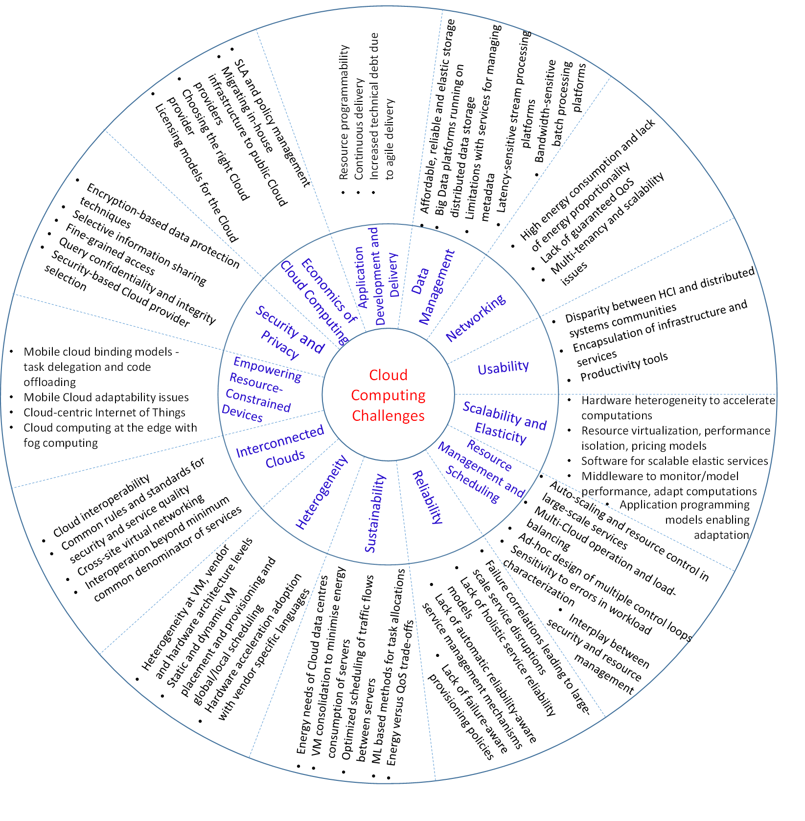
A Manifesto for Future Generation Cloud Computing: SOA and Challenges
  [Buyya, Srirama, Casale et al,
  ACM CSUR 2019]

Slide 40
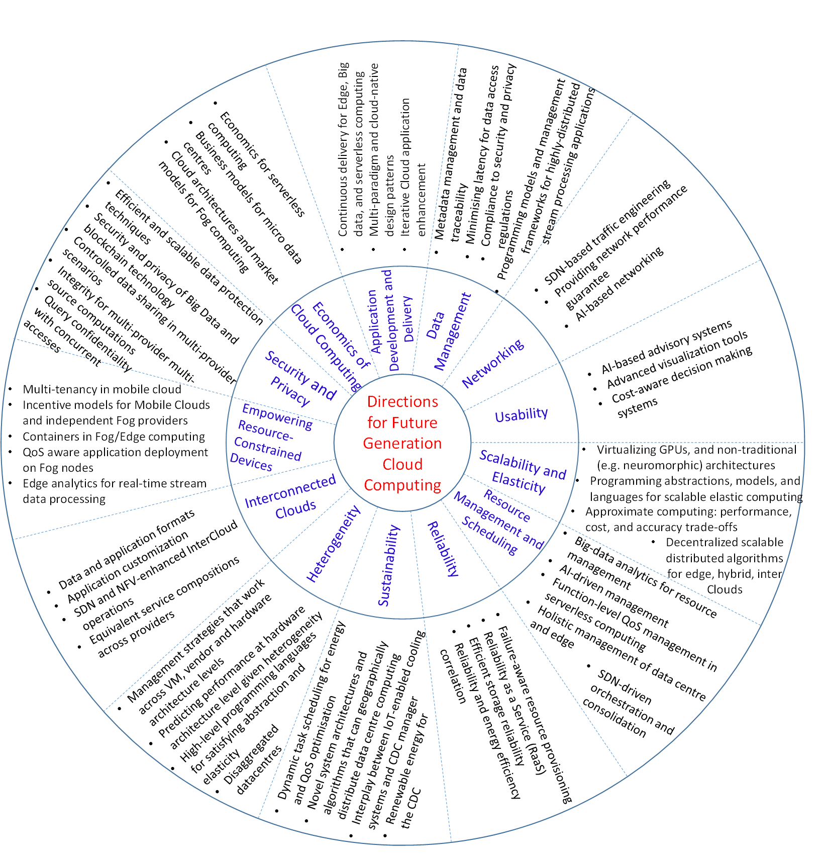
A Manifesto for Future Generation Cloud Computing: Research Directions for the Next Decade
  [Buyya, Srirama, Casale et al,
  ACM CSUR 2019]

Slide 41
Discussion and Summary
There will be significant developments across all the service models (IaaS, PaaS, and SaaS) of Cloud computing
IaaS:
  Scope for heterogeneous hardware such as CPUs and accelerators (e.g., GPUs and TPUs) and special purpose Clouds for specific applications (e.g., HPC and deep learning)
  Future generation Clouds should also be ready to embrace the non-traditional architectures (e.g. neuromorphic, quantum computing)
  Emerging trends such as containerisation, SDN and Fog/Edge computing are going to expand the research scope of IaaS by leaps and bounds
  Sustainability of CDC through utilisation of renewable energy and IoT-enabled cooling systems
  Scope for emerging trends in IaaS, such as disaggregated data centres
  Future research directions proposed for addressing the scalability, resource management and scheduling, heterogeneity, interconnected Clouds and networking challenges

Slide 42
Discussion and Summary - continued
PaaS:
  Should see significant advancements through future research directions in resource management and scheduling
  Need for programming abstractions, models, languages and systems supporting scalable elastic computing and seamless use of heterogeneous resources are proposed
    Lead to energy-efficiency, minimised application engineering cost, better portability and guaranteed level of reliability and performance
  ML, AI and Deep learning should help in dealing with the complexity, heterogeneity, scale and load balancing applications developed through PaaS
  Interesting future directions are proposed such as function-level QoS management and economics for serverless computing
  Future research directions for data management and analytics are discussed in detail along with security
    Lead to interesting applications with platform support (e.g edge analytics for real-time stream data processing in IoT and Smart Cities domains)

Slide 43
Discussion and Summary - continued
SaaS:
  Should mainly see advances from the application development and delivery, and usability of Cloud services
  A variety of agile delivery tools and Cloud standards (e.g., TOSCA) are increasingly being adopted during Cloud application development
  Future research should focus at how to continuously monitor and iteratively evolve the design and quality of Cloud applications
  Extend DevOps methods and define novel programming abstractions to support IoT, Edge computing, Big Data, and serverless computing
  Novel incentive mechanisms are required for mobile Cloud adaptability as well as for designing Fog architectures
Discussed research directions show a promising and exciting future for the Cloud computing field both technically and economically
The manifesto calls the community for action in addressing them
Notes:
Translucent programming models, languages, and APIs will be needed to enable tackling the complexity of application development while permitting control of application delivery to future-generation Clouds

Slide 44
This week in lab
No lab!
All the best for exam next week!

Slide 45
References
R. Buyya, S. N. Srirama, G. Casale et al: A Manifesto for Future Generation Cloud Computing: Research Directions for the Next Decade, ACM Computing Surveys, ISSN 0360-0300, 51(5):105, 38 pages, 2019.

